Slide 1
Quantitative Research Methods
January 30, 2023
Professor Patrick Rebuschat
p.rebuschat@lancaster.ac.uk
Notes:
Section title slide.

Slide 2
Our plan for today
Homework assignment discussion
Data wrangling
Reminder from last session
Steps 0, 1 and 2 from Handout Session 3
Exploratory data analysis
Short introduction
Steps 3 and 4 from Handout Session 3

Slide 3
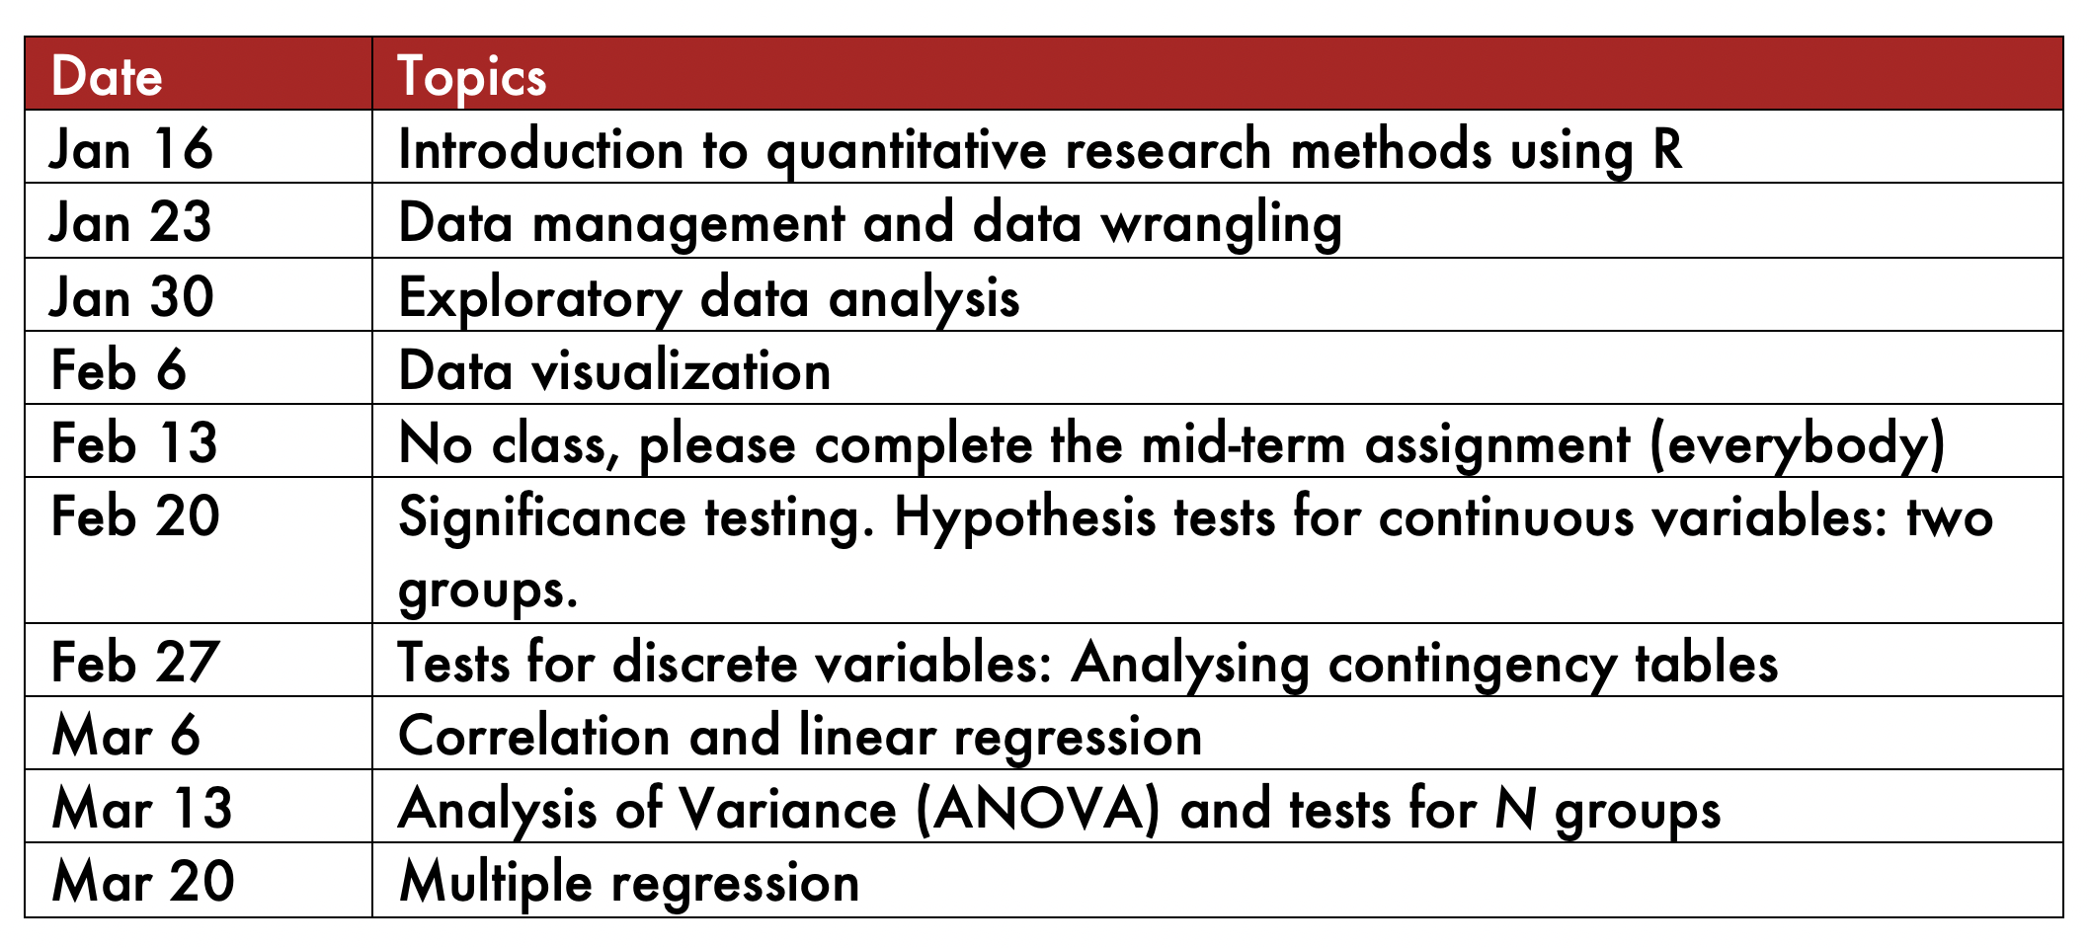
Our schedule

Slide 4
Solution to homework 2

Slide 5
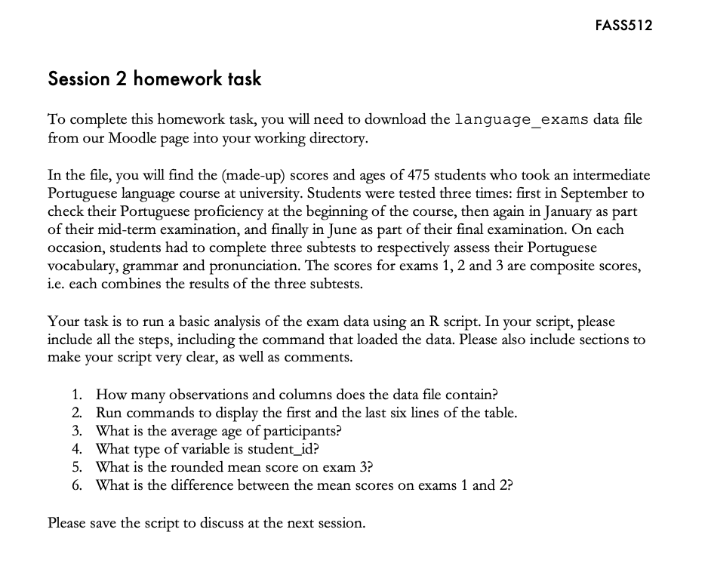
Session 2 homework
Notes:
This week, we will do our first steps in R. Please work through the following handout at your own pace.
Three important things to remember:
As you complete the handout, please type the commands in your computer. (The commands are highlighted in the document below.) That is, don’t just read the commands on the paper, please type every single one of them. This is really important: Learning to program is like practicing a conversation in a new language. You will improve gradually, but only if you practice.
If you’re stuck with something, please write down your questions (to share later in class) and try to solve the problem. Please ask your group members for support and, conversely, if another student is stuck, please try to help them out, too. This way, we develop a supportive learning environment that benefits everybody. In addition, get used to the Help pages in RStudio and start finding solutions online (discussion forums, online textbooks, etc.). This is really important, too. You will only really know how to do quantitative research and statistical analyses when you are doing your own research and dealing with your own data. At that point, you need to be sufficiently autonomous to solve problems, otherwise you will end up making very slow progress in your PhD.
Finally, if you don’t complete the handout in class, please complete the handout at home. This is important as we will assume that you know the material covered in this handout. And again, the more you practice the better, so completing these handouts at home is important.

Slide 6
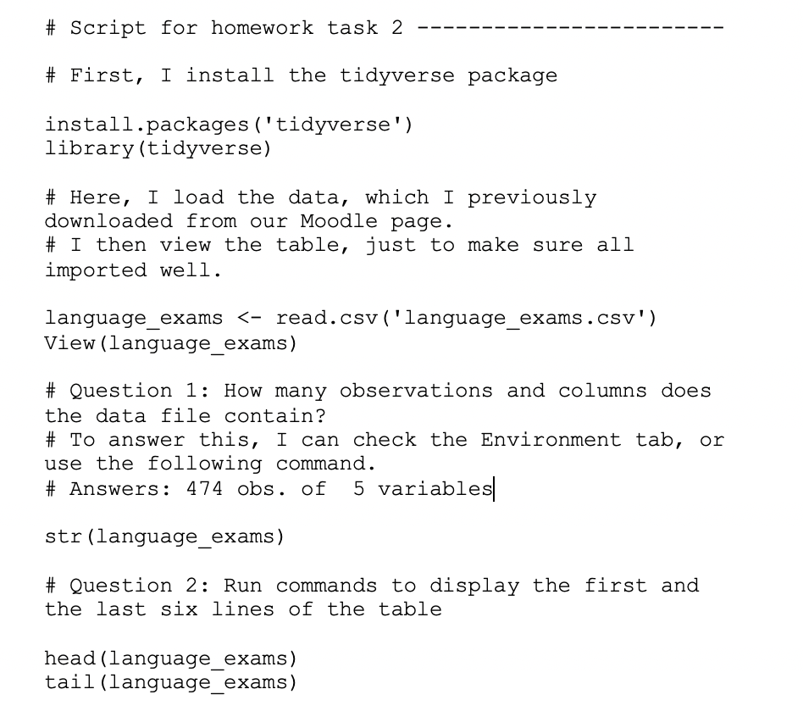
Session 2 homework
Notes:
This week, we will do our first steps in R. Please work through the following handout at your own pace.
Three important things to remember:
As you complete the handout, please type the commands in your computer. (The commands are highlighted in the document below.) That is, don’t just read the commands on the paper, please type every single one of them. This is really important: Learning to program is like practicing a conversation in a new language. You will improve gradually, but only if you practice.
If you’re stuck with something, please write down your questions (to share later in class) and try to solve the problem. Please ask your group members for support and, conversely, if another student is stuck, please try to help them out, too. This way, we develop a supportive learning environment that benefits everybody. In addition, get used to the Help pages in RStudio and start finding solutions online (discussion forums, online textbooks, etc.). This is really important, too. You will only really know how to do quantitative research and statistical analyses when you are doing your own research and dealing with your own data. At that point, you need to be sufficiently autonomous to solve problems, otherwise you will end up making very slow progress in your PhD.
Finally, if you don’t complete the handout in class, please complete the handout at home. This is important as we will assume that you know the material covered in this handout. And again, the more you practice the better, so completing these handouts at home is important.

Slide 7
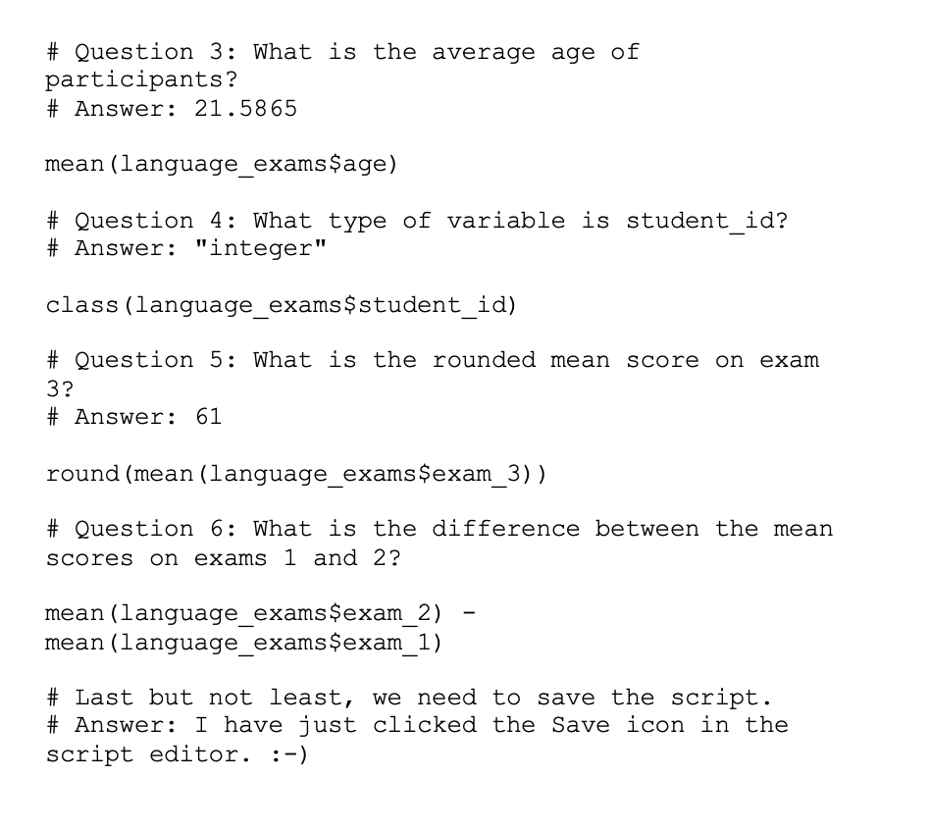
Session 2 homework
Notes:
This week, we will do our first steps in R. Please work through the following handout at your own pace.
Three important things to remember:
As you complete the handout, please type the commands in your computer. (The commands are highlighted in the document below.) That is, don’t just read the commands on the paper, please type every single one of them. This is really important: Learning to program is like practicing a conversation in a new language. You will improve gradually, but only if you practice.
If you’re stuck with something, please write down your questions (to share later in class) and try to solve the problem. Please ask your group members for support and, conversely, if another student is stuck, please try to help them out, too. This way, we develop a supportive learning environment that benefits everybody. In addition, get used to the Help pages in RStudio and start finding solutions online (discussion forums, online textbooks, etc.). This is really important, too. You will only really know how to do quantitative research and statistical analyses when you are doing your own research and dealing with your own data. At that point, you need to be sufficiently autonomous to solve problems, otherwise you will end up making very slow progress in your PhD.
Finally, if you don’t complete the handout in class, please complete the handout at home. This is important as we will assume that you know the material covered in this handout. And again, the more you practice the better, so completing these handouts at home is important.

Slide 8
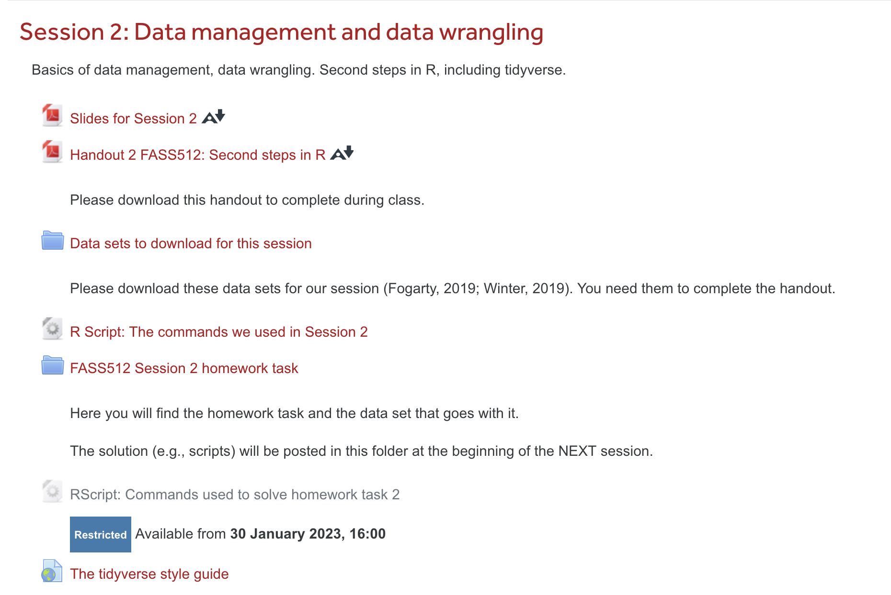
Check the R script on Moodle, download the following file: “RScript: Commands used to answer homework task”

Slide 9
Data wrangling: A reminder

Slide 10
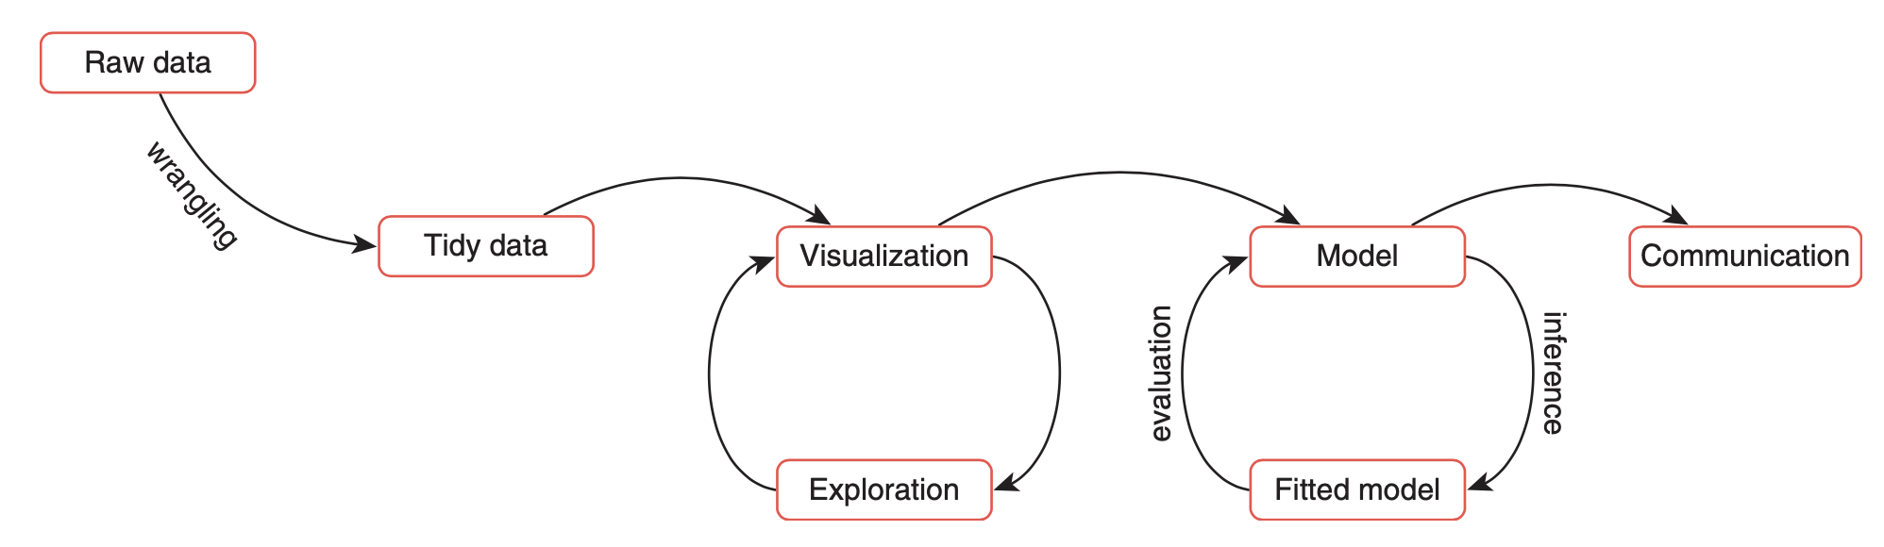
The Data Science Workflow
Reproduced from Andrews (2021)
Data science: the combined application of computational tools and statistical methods to (all aspects of) data analysis.

Slide 11
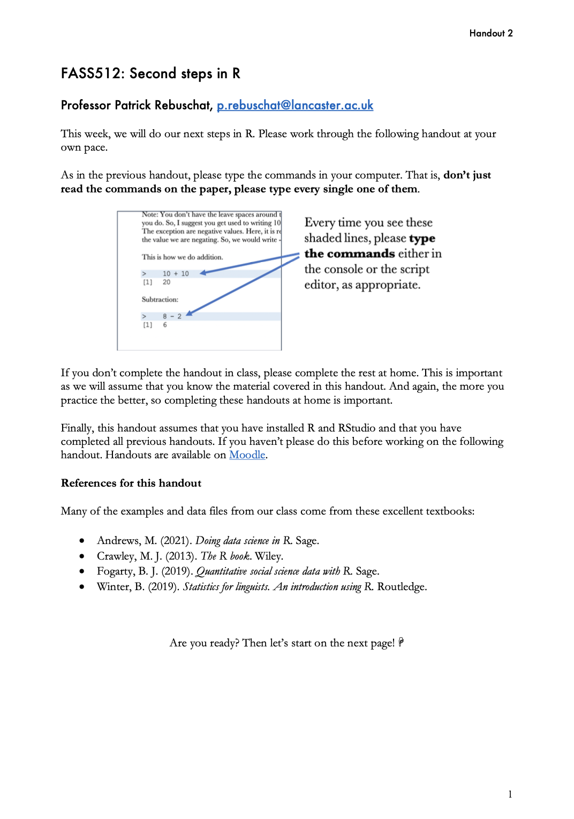
Handout 3
Let’s complete the first part of the handout and do some wrangling…
Step 0: Installing and loading packages
Step 1: What is a tibble?
Step 2: Data wrangling in the tidyverse
Notes:
This week, we will do our first steps in R. Please work through the following handout at your own pace.
Three important things to remember:
As you complete the handout, please type the commands in your computer. (The commands are highlighted in the document below.) That is, don’t just read the commands on the paper, please type every single one of them. This is really important: Learning to program is like practicing a conversation in a new language. You will improve gradually, but only if you practice.
If you’re stuck with something, please write down your questions (to share later in class) and try to solve the problem. Please ask your group members for support and, conversely, if another student is stuck, please try to help them out, too. This way, we develop a supportive learning environment that benefits everybody. In addition, get used to the Help pages in RStudio and start finding solutions online (discussion forums, online textbooks, etc.). This is really important, too. You will only really know how to do quantitative research and statistical analyses when you are doing your own research and dealing with your own data. At that point, you need to be sufficiently autonomous to solve problems, otherwise you will end up making very slow progress in your PhD.
Finally, if you don’t complete the handout in class, please complete the handout at home. This is important as we will assume that you know the material covered in this handout. And again, the more you practice the better, so completing these handouts at home is important.

Slide 12
Exploratory data analysis

Slide 13
The Data Science Workflow
Reproduced from Andrews (2021)
Data science: the combined application of computational tools and statistical methods to (all aspects of) data analysis.

Slide 14
Tukey (1977)
Exploratory data analysis
Aim: to discover potentially interesting patterns and behaviors in the data.
Confirmatory data analysis:
Aim: to propose and test models of our data

Slide 15
Tukey (1977)
Exploratory data analysis
Detectives looking for evidence at the scene of a crime
Confirmatory data analysis:
Courts making a prosecution case and evaluating evidence for and against
Image reproduced from here.

Slide 16
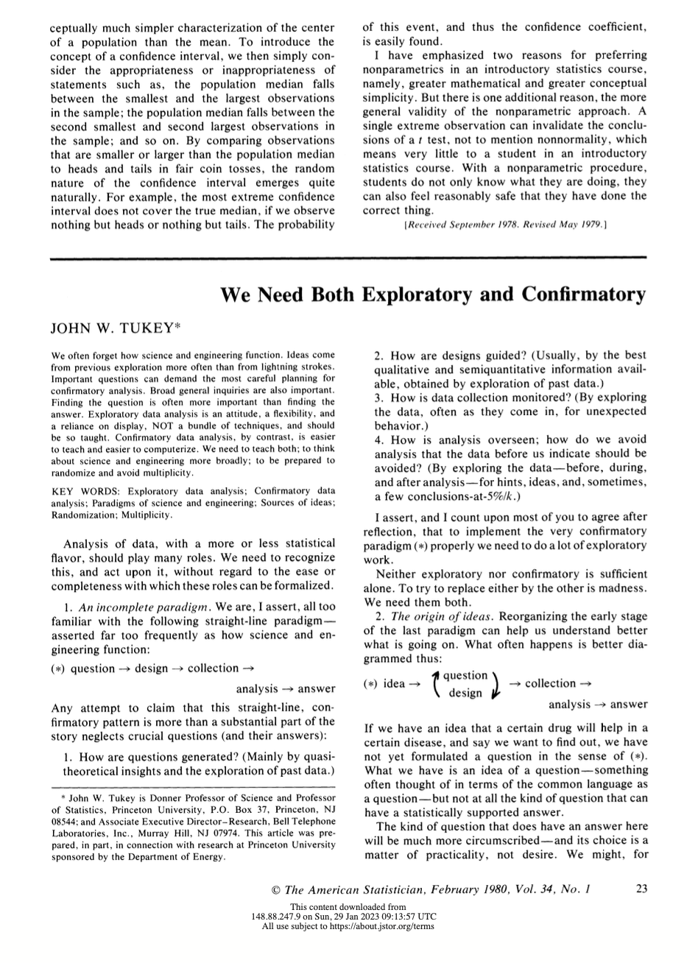
Tukey (1980)
We need both EDA and CDA.
EDA as an “attitude”
“Exploratory data analysis is an attitude, a flexibility, and a reliance on display, NOT a bundle of techniques, and should be so taught. Confirmatory data analysis, by contrast, is easier to teach and easier to computerize.” (Tukey, 1980, p. 23)

Slide 17
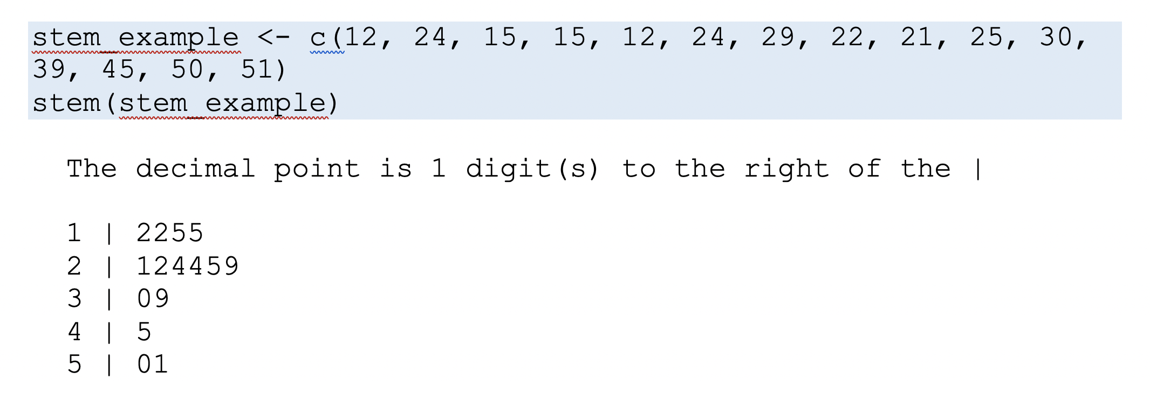
Tukey (1977, 1980)
To explore, we can use summary statistics and data visualizations.
Example: Stem-and-leaf display

Slide 18
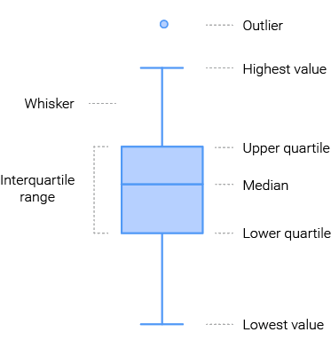
Tukey (1977, 1980)
Example: Boxplot
Upper quantile: 75%
Lower quantile: 25%
Median: 50%
Interquartile range: Range between lower and upper quartile.
Whisker length: 1.5*IQR from upper and lower quantiles respectively
Outliers: Extreme values, each bubble represents one observation
Outliers
Whisker
Upper quartile
Interquartile range
Median
Lower quartile
Whisker
Outliers

Slide 19
Types of data

Slide 20
Types of data
We can classify data types in different ways.
Continuous data
Ordinal data
Count data
Categorical data

Slide 21
Continuous data
Variables can take any value in a continuous metric space.
Between any two values (e.g., 0 and 100) can exist an infinite number of other values.
Continuous data can be ordered.
Example: height, weight, age; speed, time, distance.
Notes:
Subtype of continuous variables: Proportions, percentages, probabilities.

Slide 22
Ordinal data
Values of a variable that can be ordered but there is no natural sense of distance between these values.
First, second, third… These values have a natural order, but there is no sense of distance between them.
Example: Students scoring in first, second, third place in a test. The first might score 100, the second 45, and the third 10. Or they might score 99, 98, 97. → The data can be ordered but the distance is

Slide 23
Count data
Tallies of the number of times something has happened.
Values of count variable are ordered and also have a true sense of distance.
Example: In an exam, a score of 87 correct answers is as far as from a score of 90 as a score of 97 is from 100.

Slide 24
Categorical data
Each value takes one of a finite number of values that are categorically distinct.
Values of categorical variables are usually names, labels. Hence, also known as nominal data.
Values of categorical variables cannot be placed in order, nor is there a natural sense of distance between them.
Example: nationality, country, occupation, experimental conditions (experimental vs. control condition)

Slide 25
Characterizing distributions

Slide 26
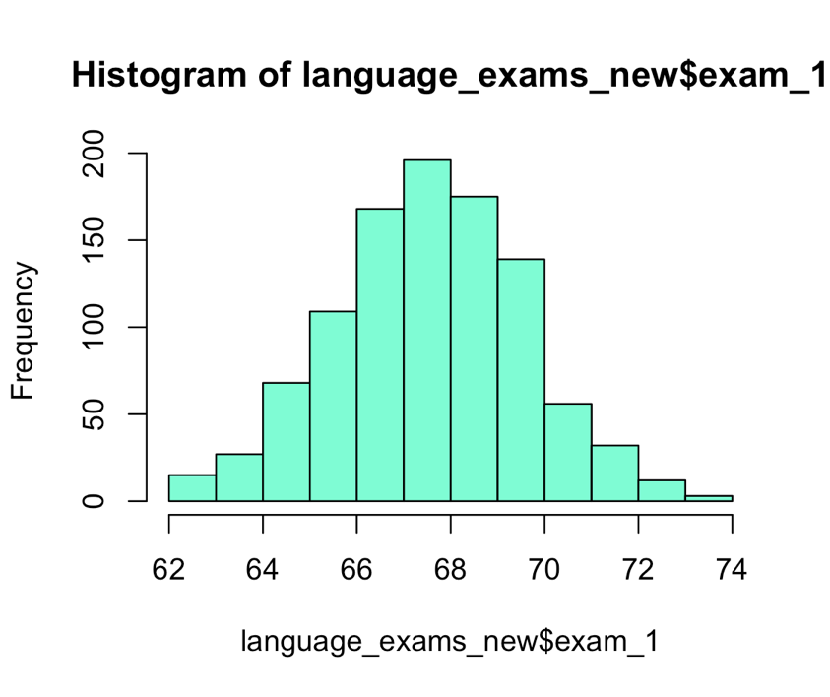
Characterizing distributions
We can describe (univariate) distributions in terms of three major features:
Location (central tendency)
Spread (dispersion)
Shape

Slide 27
Location (central tendency)
The location of a distribution describes where most of the value fall.
Example: Most of the exam scores in the histogram.
Notes:
Dispersion
Scale, spread of distribution. Tells us how dispersed or spread out the distribution is.
Tells us how much variation there is in the distribution’s values or how far apart the values are from one another on average.

Slide 28
Spread (dispersion)
Tells us how dispersed or spread out the distribution is.
Are most of the scores clustered around the central value? → Short ”tails”
Are they more spread out? → Long “tails”
”tails” of the distribution
Notes:
Dispersion
Scale, spread of distribution. Tells us how dispersed or spread out the distribution is.
Tells us how much variation there is in the distribution’s values or how far apart the values are from one another on average.

Slide 29
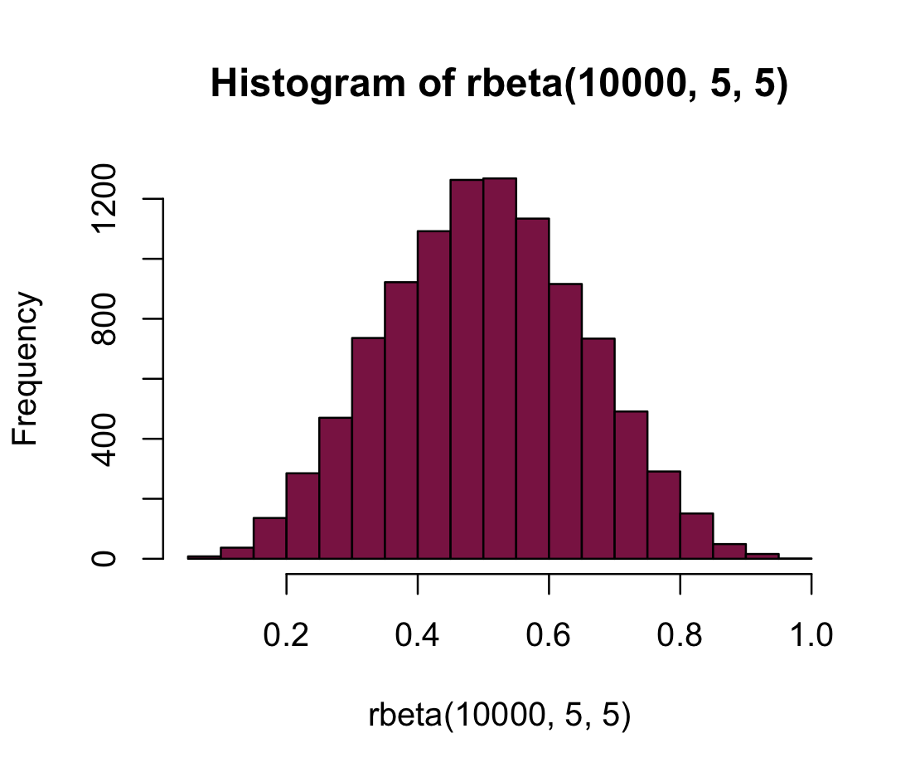
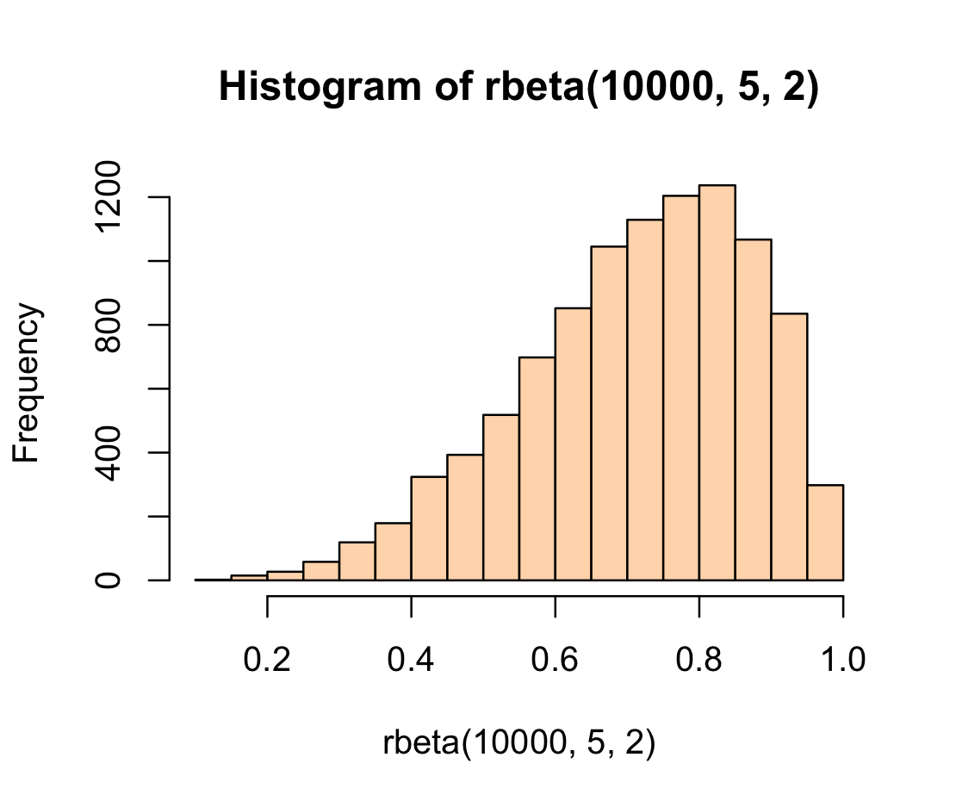
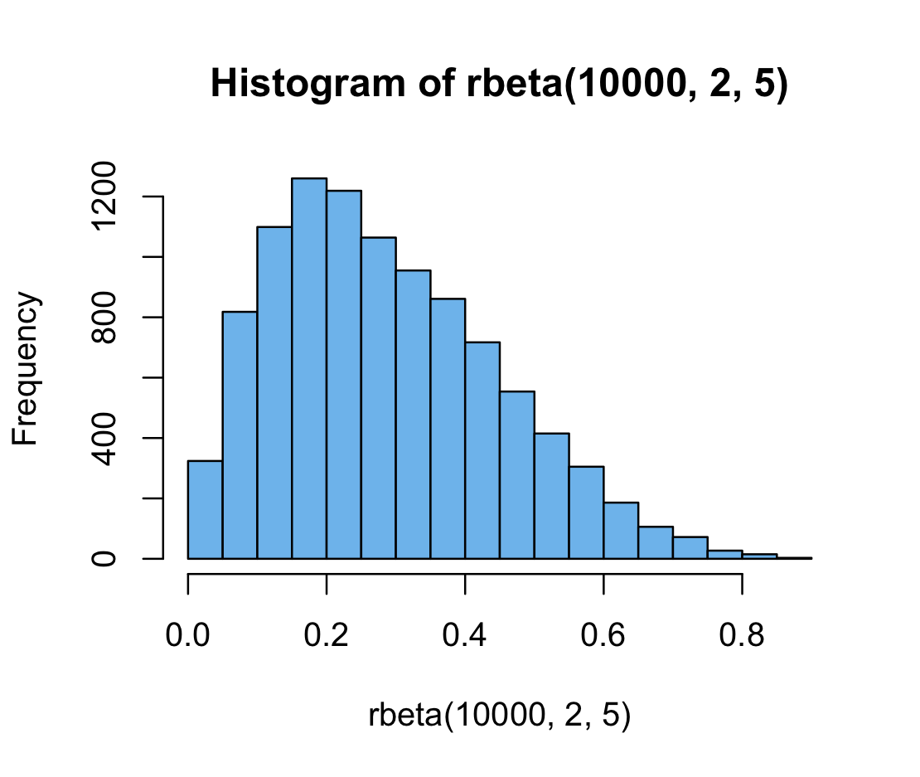
Shape: Skewness
normal
How much (a)symmetry there is in the distribution.
negative skew
positive skew
Notes:
Left, negative skew means that the left tail is longer than the one on the right. Right, positive skew means that the right tail is longer than the one on the left.
hist(rbeta(10000,5,2), col = "peachpuff")
hist(rbeta(10000,2,5), col = "skyblue2")
hist(rbeta(10000,5,5), col = "violetred4")

Slide 30
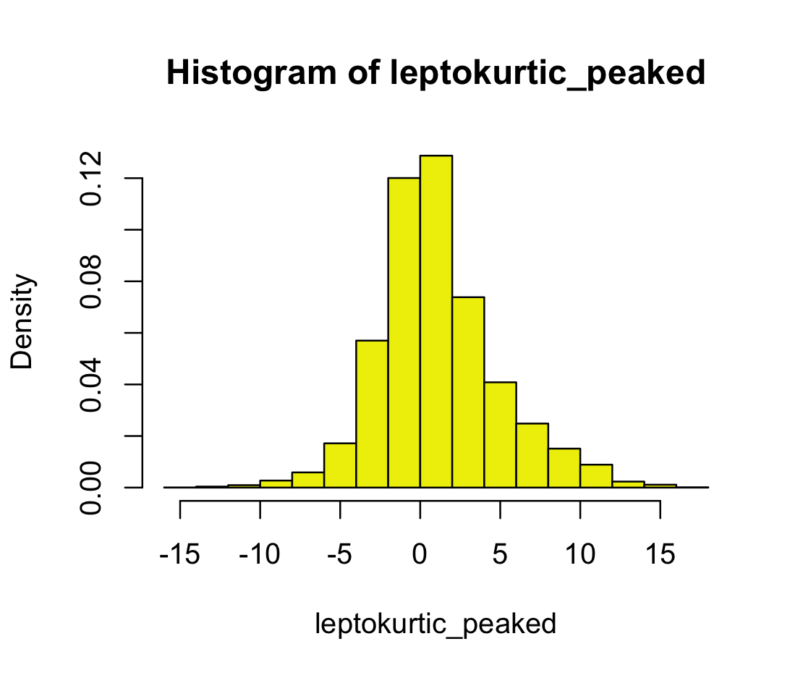
Shape: Kurtosis
Peaked: leptokurtic
Flat: platykurtic
Image reference
Notes:
platykurtic

Slide 31
Summary statistics

Slide 32
Summary statistics (models of our data)
Measures of central tendency: mean, median, mode
Measures of dispersion: variance, standard deviation, range measures

Slide 33
Measures of central tendency

Slide 34
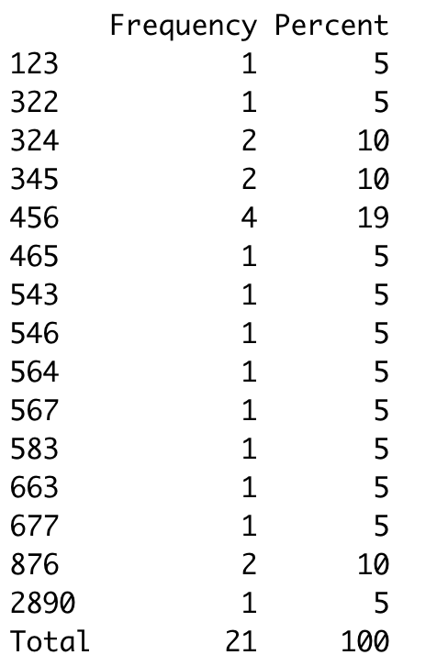
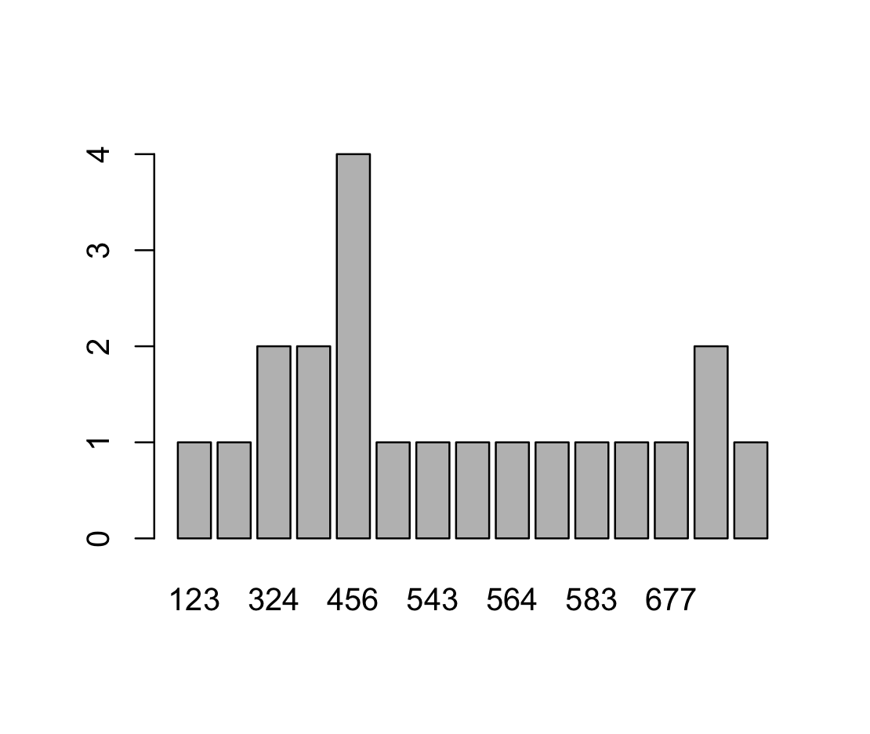
Mode
The value with the highest frequency.
Can be used for categorical, continuous, count, and ordinal data.

Slide 35
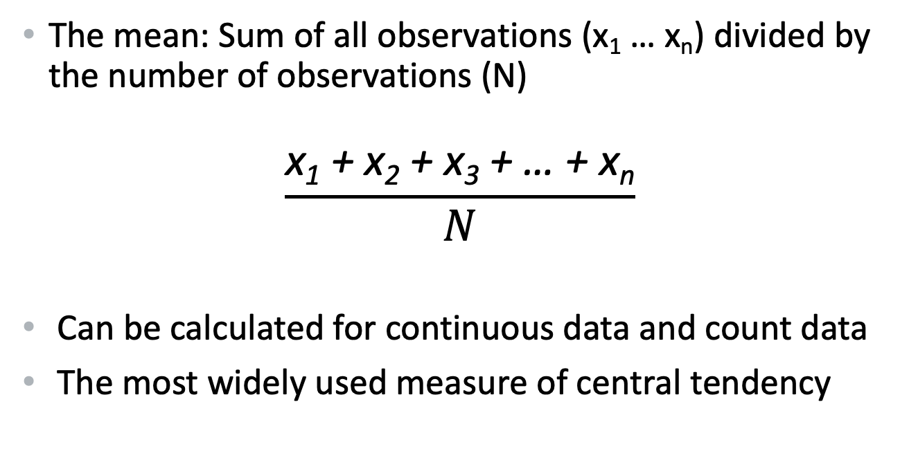
Arithmetic mean
The mean: Sum of all observations (x₁ … x_{n}) divided by the number of observations (N)
$$\frac{\text{x}\text{1}\text{ + }\text{x}\text{2}\text{ + }\text{x}\text{3}\text{ + … + }\text{xn}}{N}$$
Can be calculated for continuous data and count data
The most widely used measure of central tendency
Notes:
Population mean μ: Consists of every possible observation and not just a subset of them
Sample mean x-bar: statistical sample (a subset of the population)
The most widely used measure of central tendency

Slide 36
Median
The middle point in a sorted list of values.
Can be used for continuous, ordinal, and count data
To calculate the median:
First sort the values, then find the middle point.

Slide 37
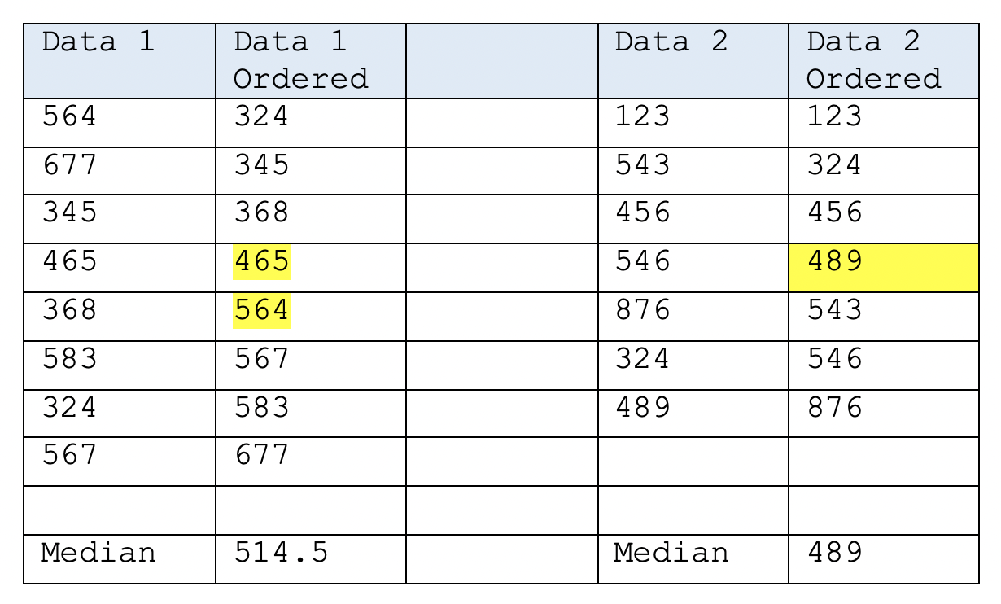
Median
If there’s an odd number of values:
There is only one point in the middle of the sorted list of values. That’s the median.

Slide 38
Median
If there’s an even number of values:
Find the two points in the middle of the sorted list.
The median is the arithmetic mean of these two points.
Here, (465 + 564) / 2 = 514.5

Slide 39
Median

Slide 40
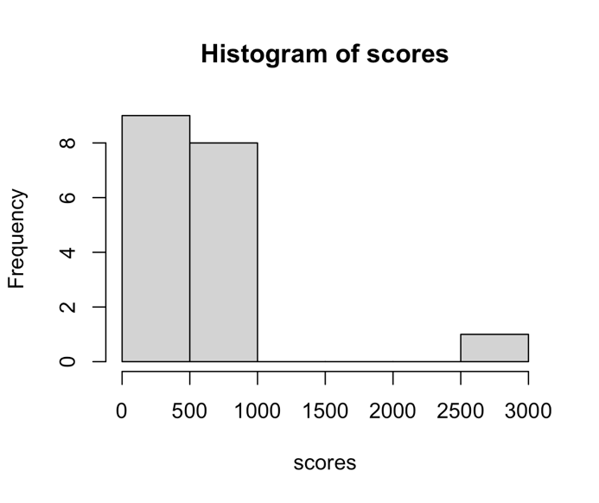
Robust measures of central tendency
The mean is the most widely used summary statistic.
But: It’s not a very “robust” statistic as it’s easily affect by extreme values (outliers).
Compare:
M with outlier = 612
M without outlier = 499
Notes:
> scores[-4] %>% mean()
[1] 498.35
> mean(scores) # With the extreme value (the fourth in the sequence)
[1] 612.2381

Slide 41
Robust measures of central tendency
The median is a more robust statistics; it’s not easily affected by extreme scores.
Compare:
Median with outlier: 465
Median without outlier: 461
Notes:
> scores[-4] %>% mean()
[1] 498.35
> mean(scores) # With the extreme value (the fourth in the sequence)
[1] 612.2381

Slide 42
Compare mean and median
When there are extreme values, the median is a better model of our data.
M with outlier = 612
Median with outlier: 465
M without outlier = 499
Median without outlier: 461
So why not just use the median?
Notes:
> scores[-4] %>% mean()
[1] 498.35
> mean(scores) # With the extreme value (the fourth in the sequence)
[1] 612.2381

Slide 43
More robust alternatives to the standard mean
Trimmed mean: Extreme values are removed before calculating the mean as normal (trim() function)
“Winsorized” mean: Extreme values are replaced with values at the thresholds of the extremes, e.g. the 90th percentile.
So, why not just always used these?
Whatever you choose, justify your decision and be transparent about it in the report.

Slide 44
Measures of dispersion

Slide 45
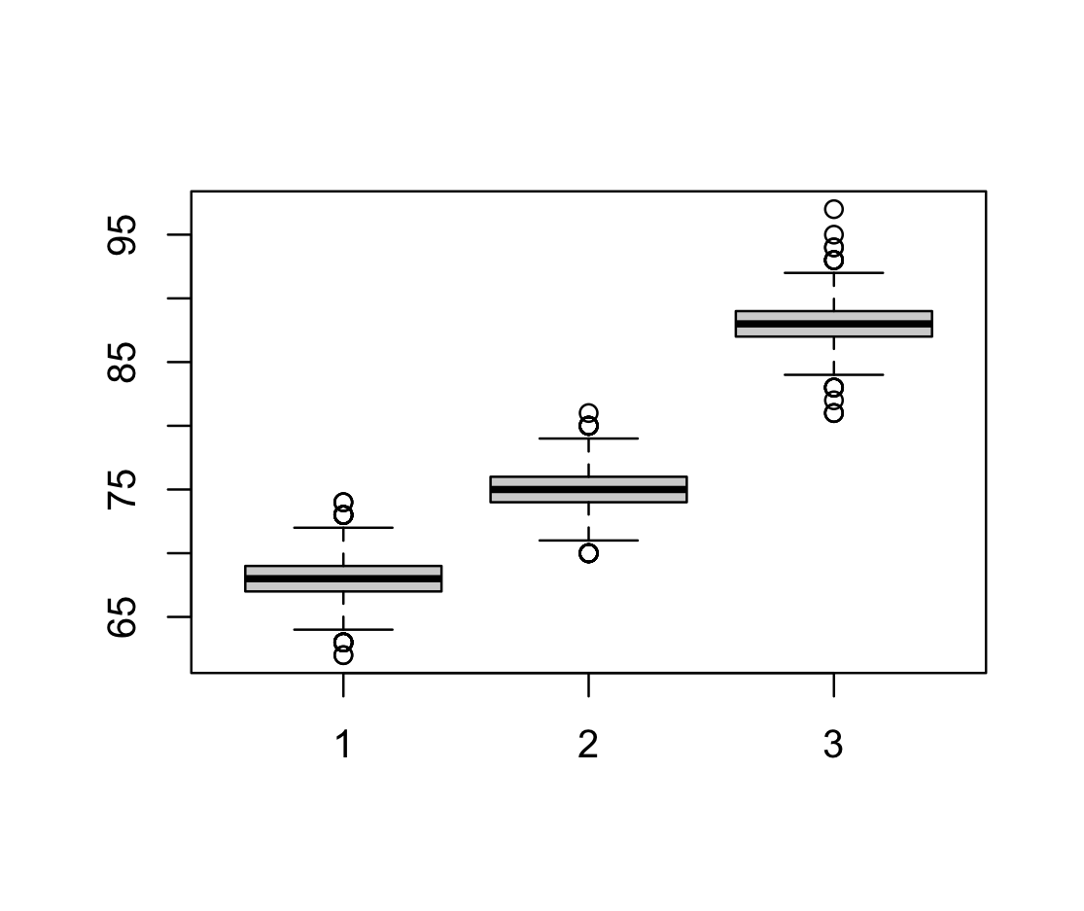
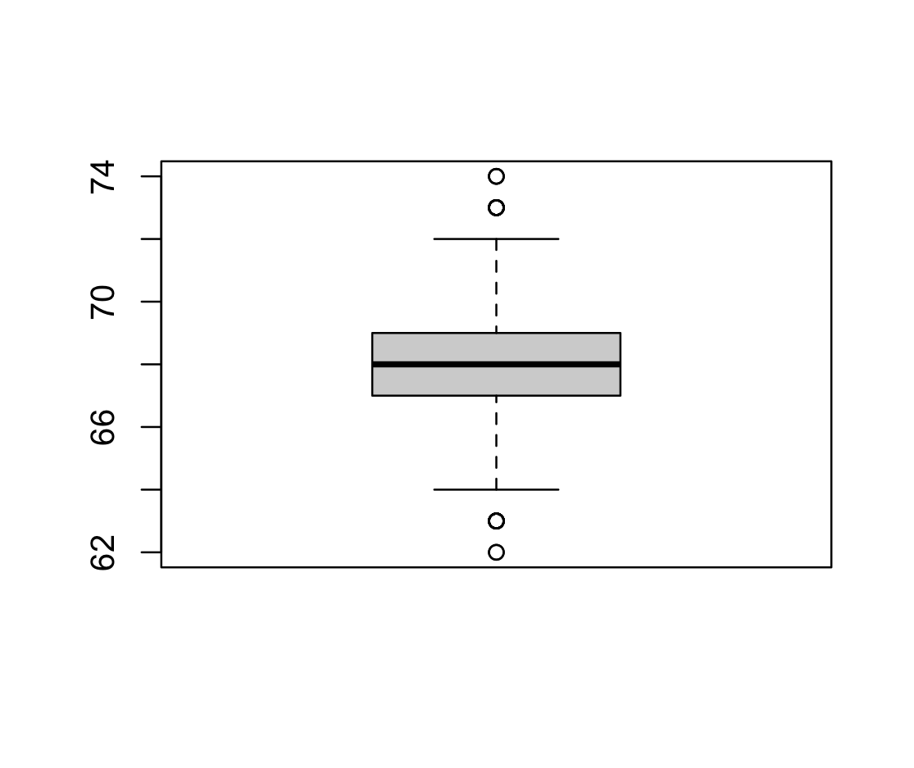
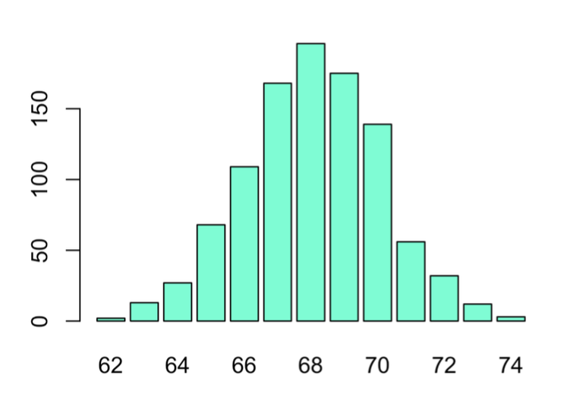
Measures of dispersion
Tell us how the observations in our variables are spread out.
Provide information about the variability in our data.
Best practice:
Report a measure of central tendency and a measure of dispersion (e.g., M and SD)

Slide 46
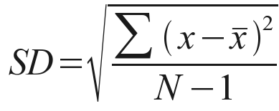
Standard deviation
Measure of dispersion around the mean
To calculate the SD:
Calculate the mean for the sample: x̅
Calculate, for each data point (x), its difference from the mean and square this value: (x - x̅)
Sum up the squared differences: (x - x̅)²
Divide the “sum of squares” (x - x̅)² by the number of observations minus 1 (N – 1).
Take the square the root of this number.

Slide 47
Range
Distance between the smallest and largest data point.
Not very informative as it exclusively based on the most extreme values…
Example: age range in our handout
Minimum age = 18
Maximum age = 25
Range = 7

Slide 48
Interquartile range
Another way of measuring dispersion is by means of the interquartile range (IQR).
This divides the sample data into quartiles (Q1, Q2, Q3 and Q4).
Difference between Q1 and Q3 is called the interquartile range.
Notes:
Q1 = 25% of data points fall below this value
Q2 = 50% of data points are above this point, 50% are below (median)
Q3 = 75% of all data points fall below this value, 75th percentile
Q4 = 100% of all data fall below this poi

Slide 49
Practical: Data wrangling and exploratory data analysis

Slide 50
Handout 3
Step 3: Exploratory data analysis
Step 4: Our first graphic explorations
Notes:
This week, we will do our first steps in R. Please work through the following handout at your own pace.
Three important things to remember:
As you complete the handout, please type the commands in your computer. (The commands are highlighted in the document below.) That is, don’t just read the commands on the paper, please type every single one of them. This is really important: Learning to program is like practicing a conversation in a new language. You will improve gradually, but only if you practice.
If you’re stuck with something, please write down your questions (to share later in class) and try to solve the problem. Please ask your group members for support and, conversely, if another student is stuck, please try to help them out, too. This way, we develop a supportive learning environment that benefits everybody. In addition, get used to the Help pages in RStudio and start finding solutions online (discussion forums, online textbooks, etc.). This is really important, too. You will only really know how to do quantitative research and statistical analyses when you are doing your own research and dealing with your own data. At that point, you need to be sufficiently autonomous to solve problems, otherwise you will end up making very slow progress in your PhD.
Finally, if you don’t complete the handout in class, please complete the handout at home. This is important as we will assume that you know the material covered in this handout. And again, the more you practice the better, so completing these handouts at home is important.

Slide 51
Questions?

Slide 52
Quantitative Research Methods
January 30, 2023
Professor Patrick Rebuschat
p.rebuschat@lancaster.ac.uk
Notes:
Section title slide.

Slide 53
The PPDAC Cycle
Adapted from Spiegehalter (2019)
Understanding and clearly defining the problem
Deciding on strategy to answer the question(s)?
Interpretation
Conclusion
Dissemination
Sharing of data and scripts
New ideas
What to measure and how?
Study design?
Data collection methods?
Ethics approval
Preregistration?
PROBLEM
CONCLUSION
PLAN
Open and reproducible science
Exploratory data analysis
Visualization
Hypothesis testing
ANALYSIS
DATA
Collection
Management
Cleaning (from raw to tidy data)

